Slide 1

Data Warehousing Integration
Batch - D
Team Members:
Aarthi P, Bavatharani S, Clarina Jones R, Vijaya Harcini J

Slide 2
Data Warehousing Integration
Agenda
Problem Statement
Solution Architecture
Tools & Technologies Used
ETL Pipeline Overview
Execution Steps
Results & Insights
Conclusion

Slide 3




Data Warehousing Integration
Problem Statement
Fragmented data across multiple systems
Hard to analyze trends
No centralized warehouse

Slide 4
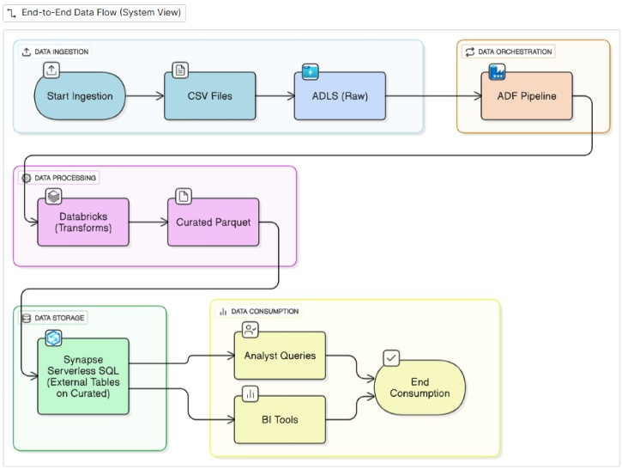

Data Warehousing Integration
Solution Architecture

Slide 5




Data Warehousing Integration
Azure Data Factory
Orchestration
Azure Data Lake Storage Gen 2
Tools & Technologies Used
Storage
Azure Data Bricks
Transformation
Azure Synapse Analytics
Data warehouse

Slide 6

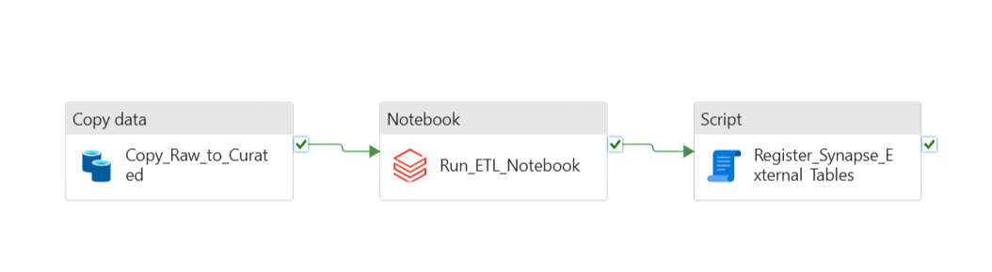
Data Warehousing Integration
Overview
ETL Pipeline Overview
Ingest with ADF → ADLS
Transform with Databricks
Load into Synapse
Validate with SQL

Slide 7

Data Warehousing Integration
Setup environment (ADLS, ADF, Synapse, Databricks)
Ingest raw CSVs
Transform into curated datasets
Load into star schema
Validate data with queries
Orchestrate end-to-end
Execution Steps

Slide 8
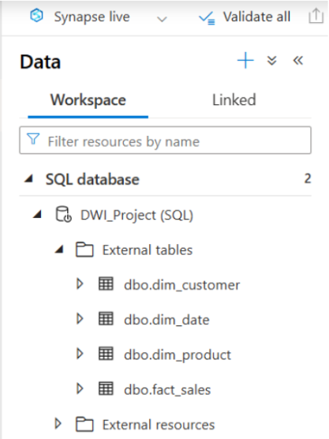
Data Warehousing Integration
Results & Insights
Star schema built (Fact + Dimensions)

Slide 9
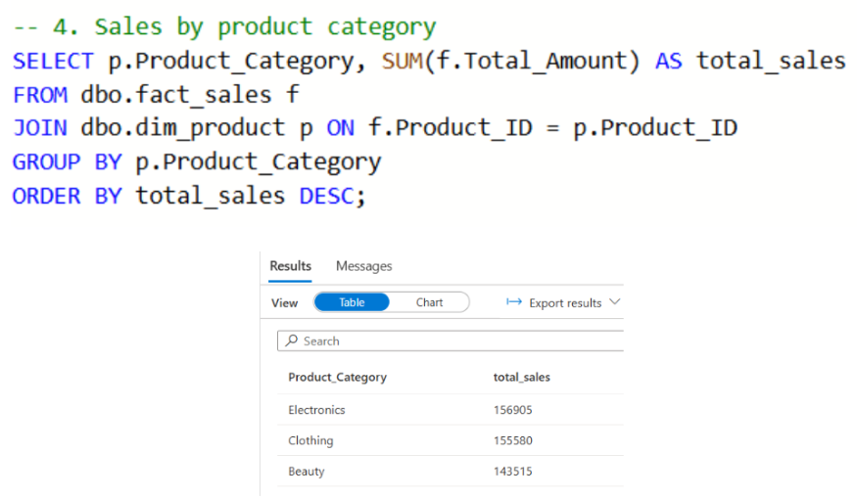
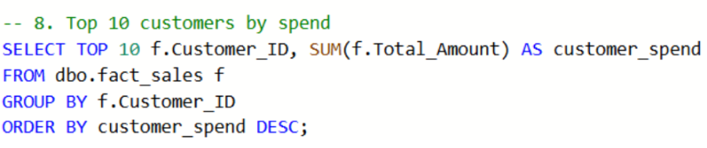
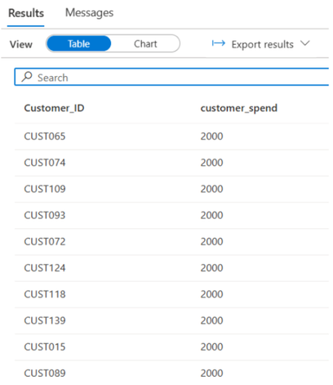
Data Warehousing Integration
Results & Insights
Top products & customers

Slide 10
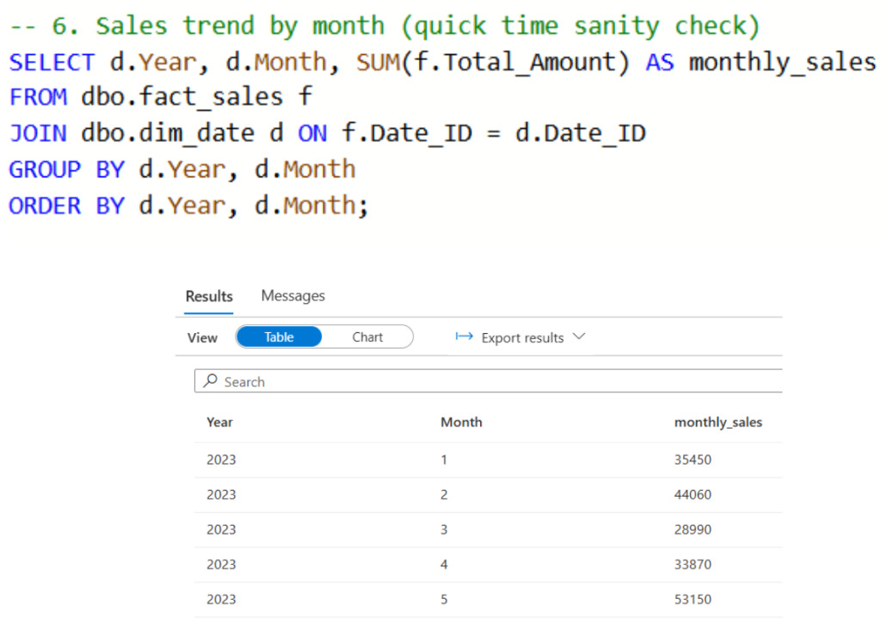
Data Warehousing Integration
Results & Insights
Sales trends

Slide 11
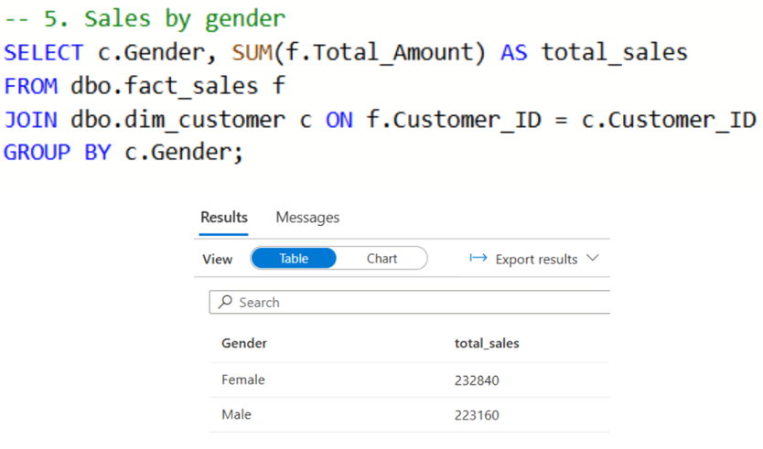
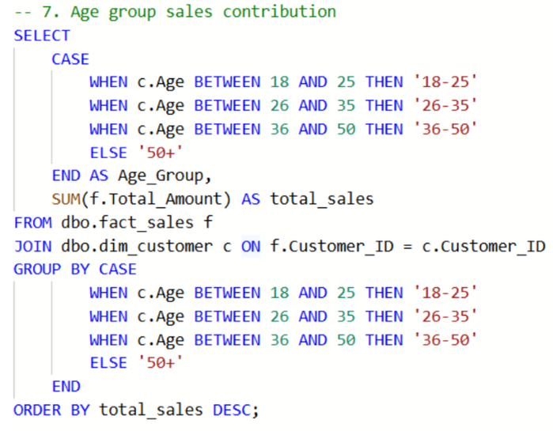
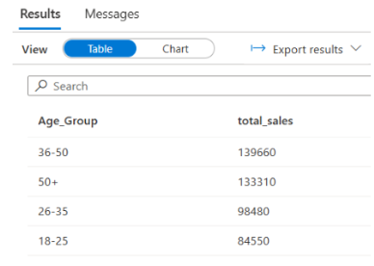
Data Warehousing Integration
Results & Insights
Gender/ Age breakdown

Slide 12

Data Warehousing Integration
Automated ETL pipeline built on Azure
Clean, reliable, analytics-ready data
Ready for BI dashboards & future scaling
Conclusion

